Slide 1
CIS 4930/6930-002 Data Visualization
TREES & GRAPHS
Paul Rosen
Assistant Professor
University of South Florida
slides credits Alex Bigelow (U of Utah), Miriah Meyer (U of Utah), Hanspeter Pfister (Harvard), Jeff Heer (Stanford)

Slide 2
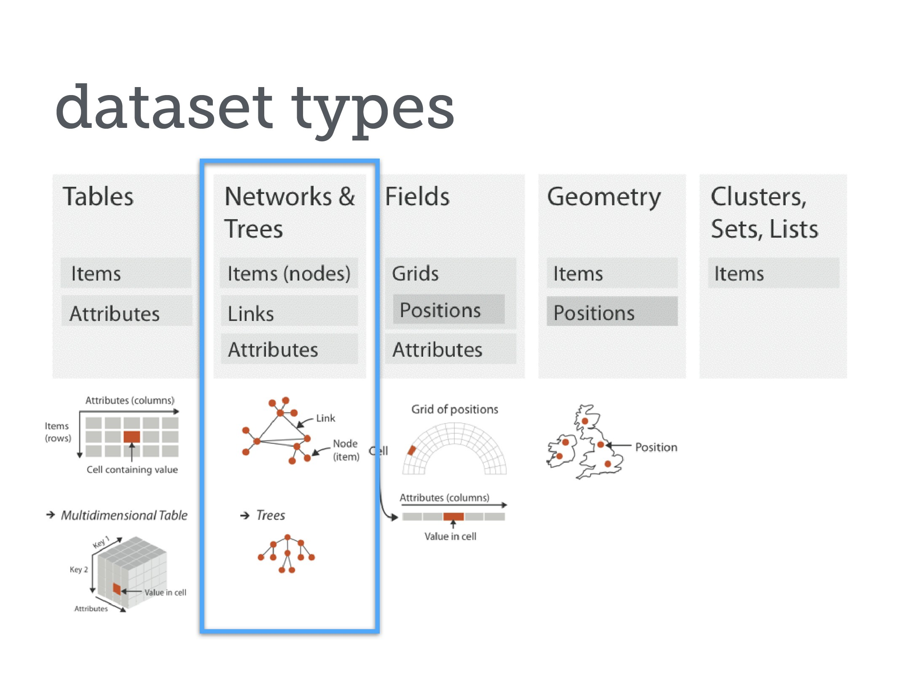

Slide 3
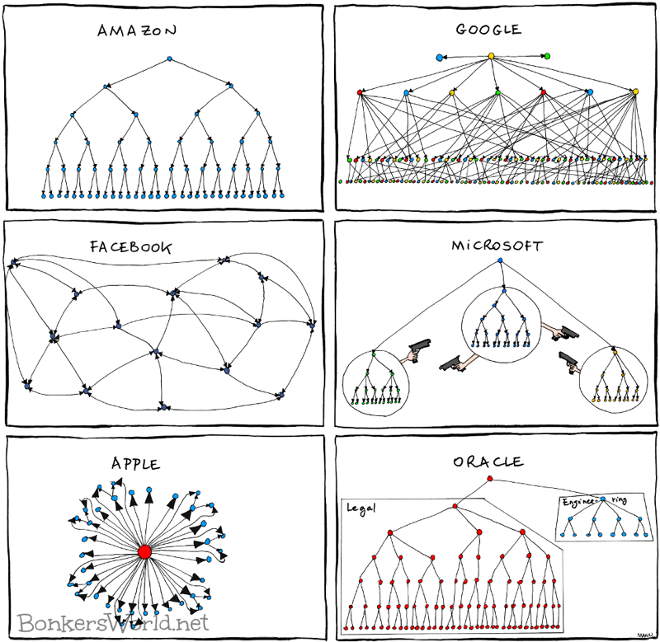
nk
d

Slide 4
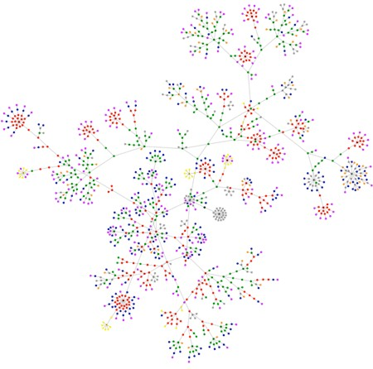
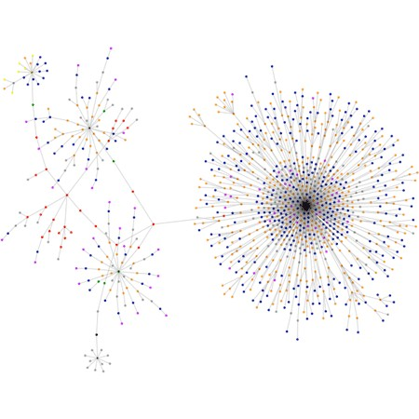
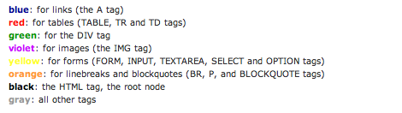
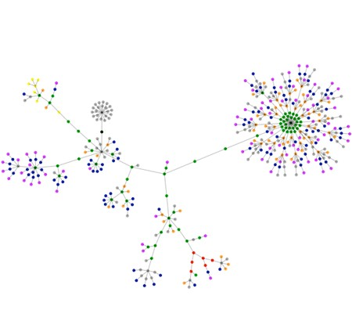
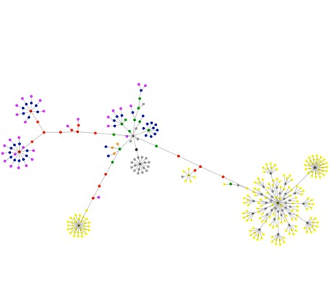
boingboing.net
cnn.com
apple.com
wired.com
Webpages as Graphs

Slide 5


Paul Butler

Slide 6
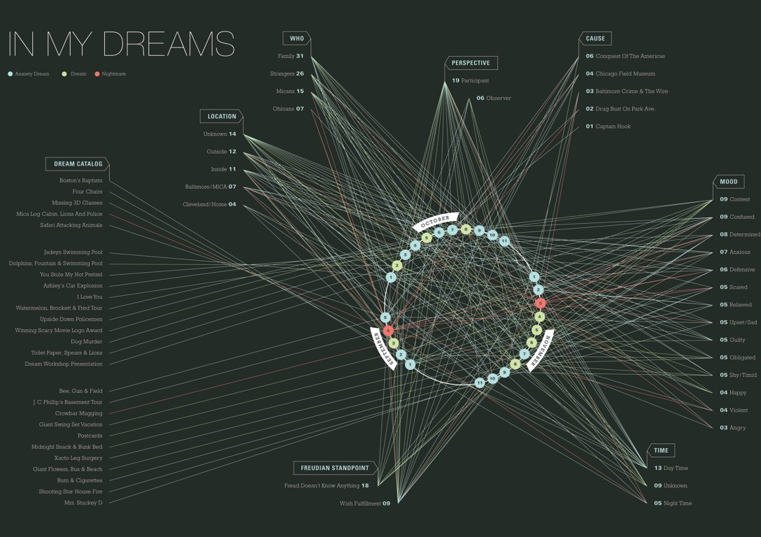
Kailie Parrish

Slide 7
DEFINITIONS

Slide 8



GRAPH
A graph G consists of
V - a collection of vertices (or nodes)
E - a set of edges consisting of vertex pairs
An edge e_{xy} = (x,y) connects two vertices x and y
Example
V={1,2,3,4}
E={(1,2),(1,3),(2,3),(3,4),(4,1)}
1
3
2
4
2
3
1
4
1
2
3
4

Slide 9
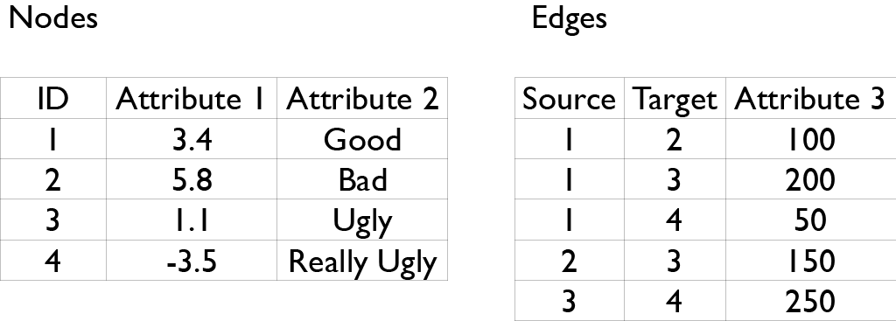
2
3
1
3
2
1
1
3
2
4
4
4

Slide 10
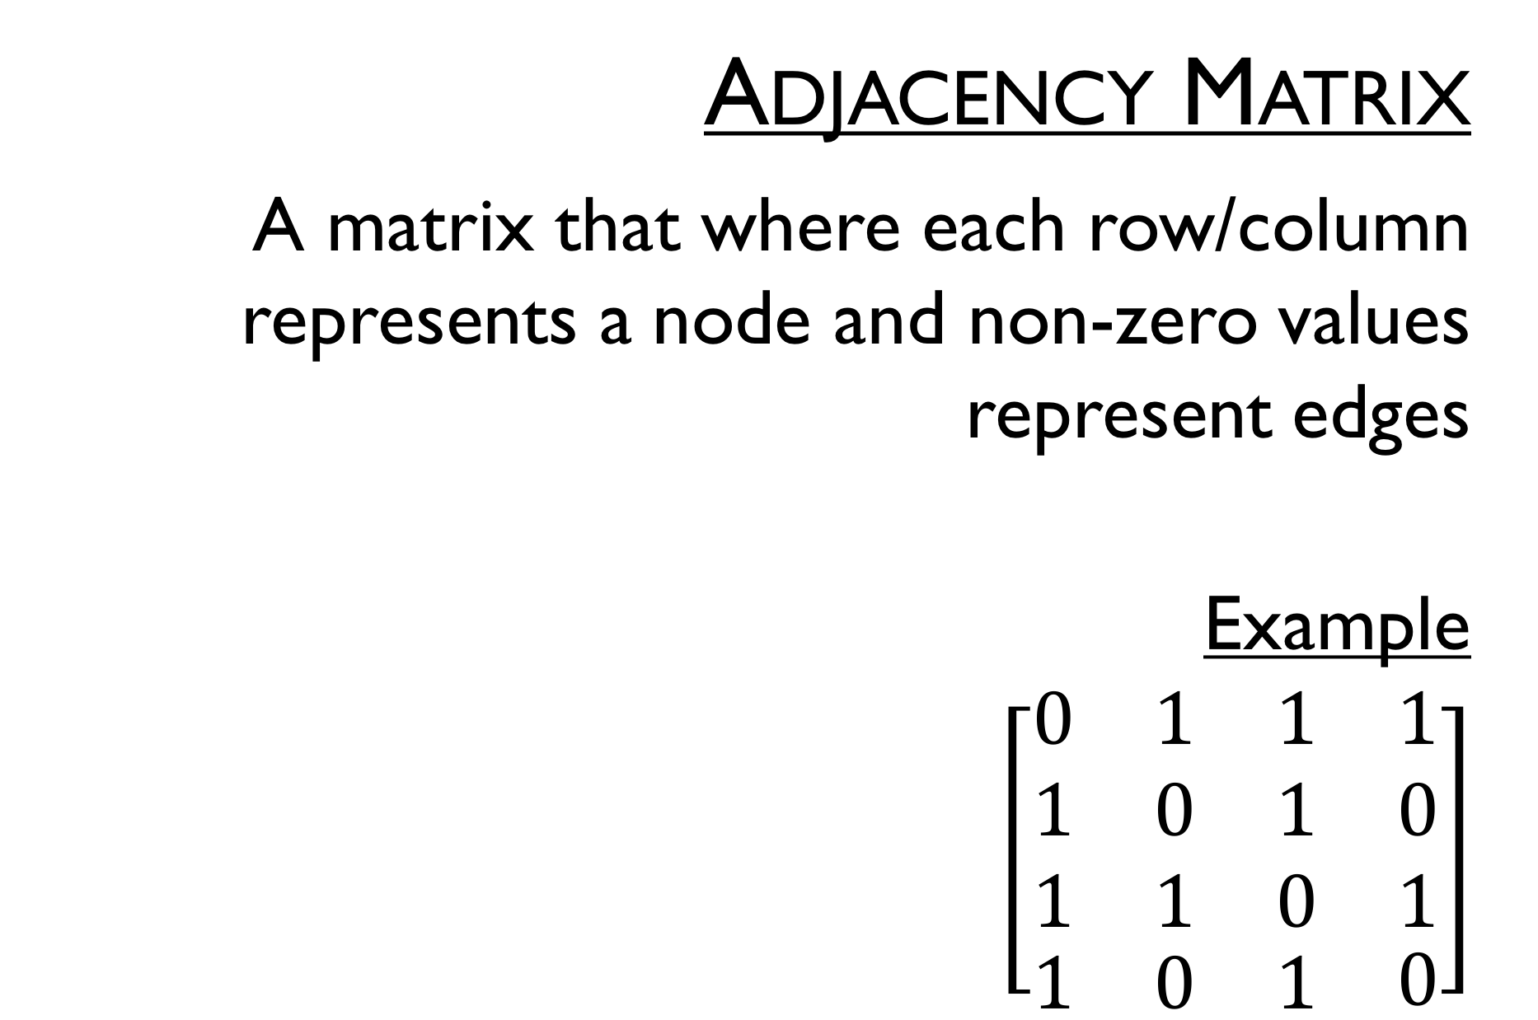
Adjacency Matrix
A matrix that where each row/column represents a node and non-zero values represent edges
Example
$\left[\begin{matrix}\begin{matrix}0 & 1 & 1 \\ 1 & 0 & 1 \\ 1 & 1 & 0\end{matrix} & \begin{matrix}1 \\ 0 \\ 1\end{matrix} \\ \begin{matrix}1 & 0 & 1\end{matrix} & 0\end{matrix}\right]$
1
3
2
4

Slide 11
GRAPHS & TREES
graphs
model relationships about data
nodes and edges
trees
graphs with hierarchical structure
nodes as parents and children

Slide 12



a bunch of definitions
0.3
2
2
1
5
0.1
3
2
A directed graph
An undirected graph
Weighted
Unconnected
Node degrees
root
0
parent
1
1
child
leaf
2
2
2
A cycle
An acyclic graph
A connected acyclic graph,
a.k.a. a tree
A rooted tree or hierarchy
Node depths

Slide 13
VISUALIZING TREES

Slide 14
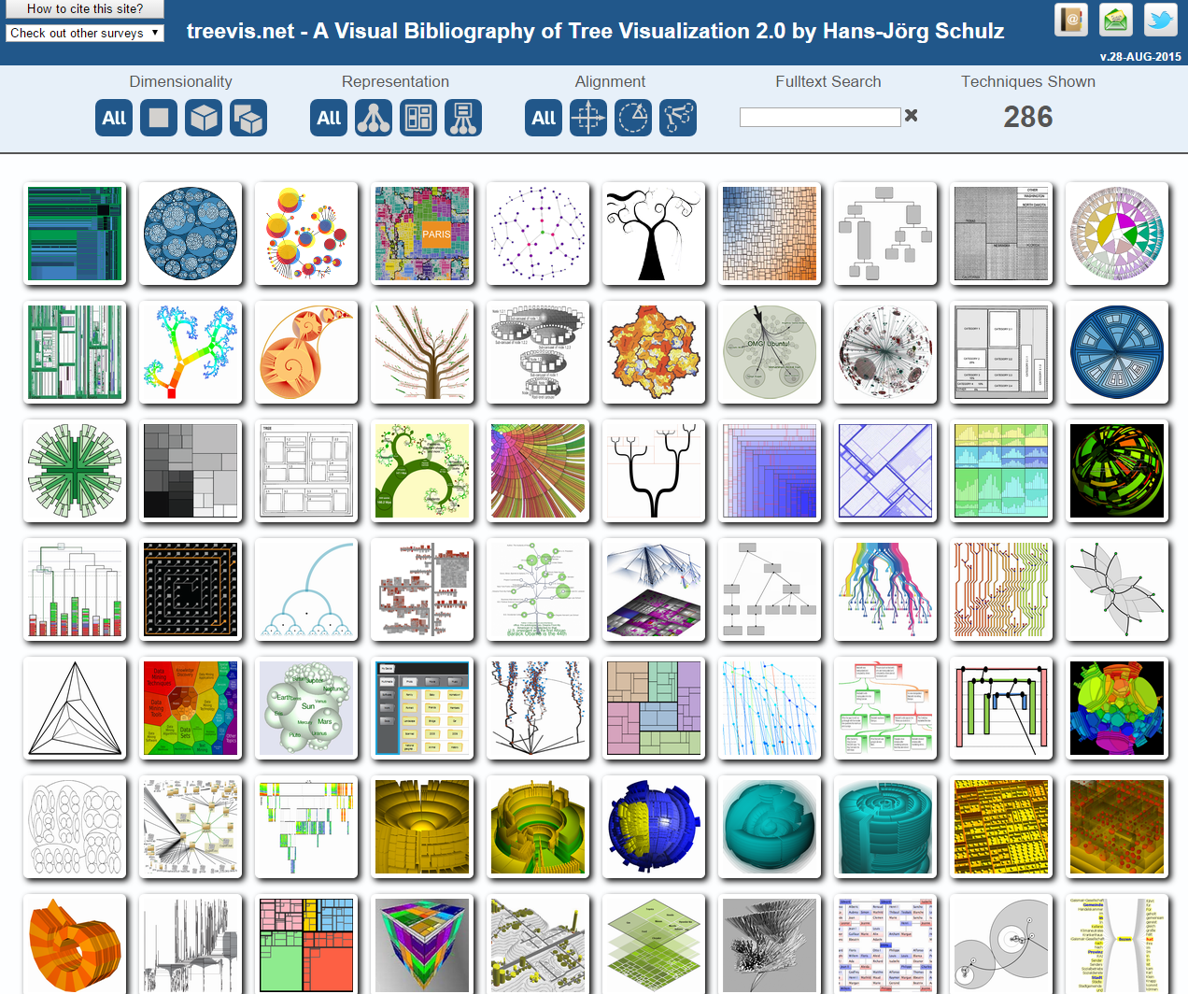
http://treevis.net/

Slide 15
ROOTED TREES
recursion makes it elegant and fast to draw trees
approaches:
node link
layered
indentation
enclosure

Slide 16
NODE-LINK DIAGRAMS
nodes are distributed in space, connected by straight or curved lines
typical approach is to use 2D space to break apart breadth and depth
often space is used to communicate hierarchical orientation

Slide 17
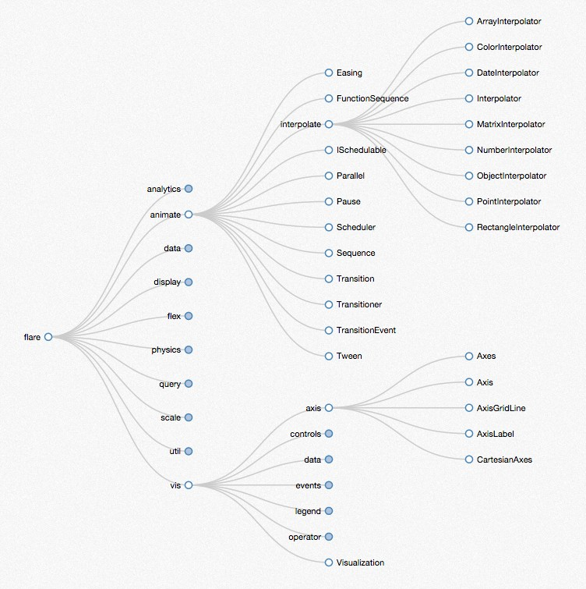
http://mbostock.github.io/d3/talk/20111018/tree.html

Slide 18
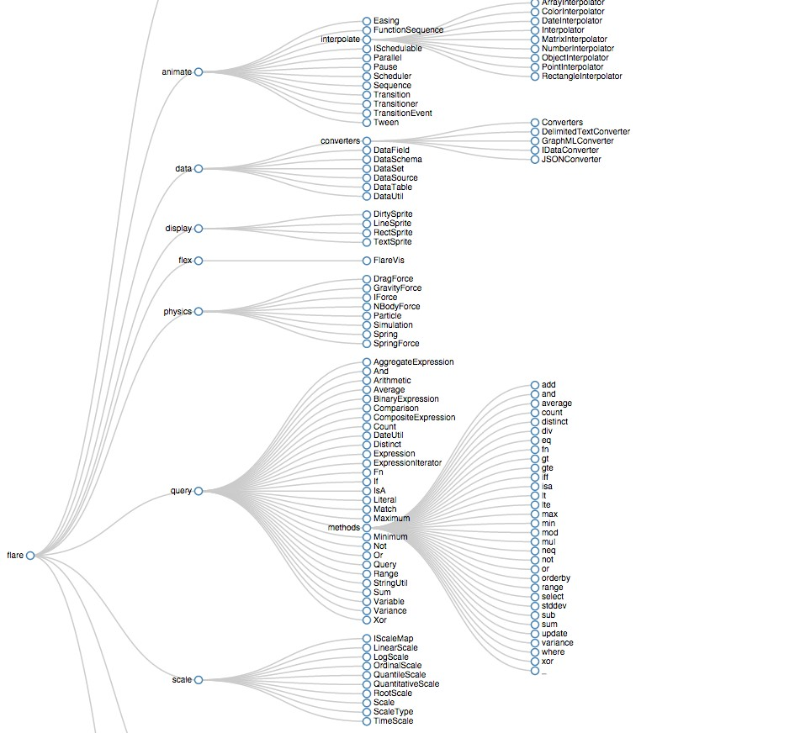
http://bl.ocks.org/mbostock/4339184

Slide 19
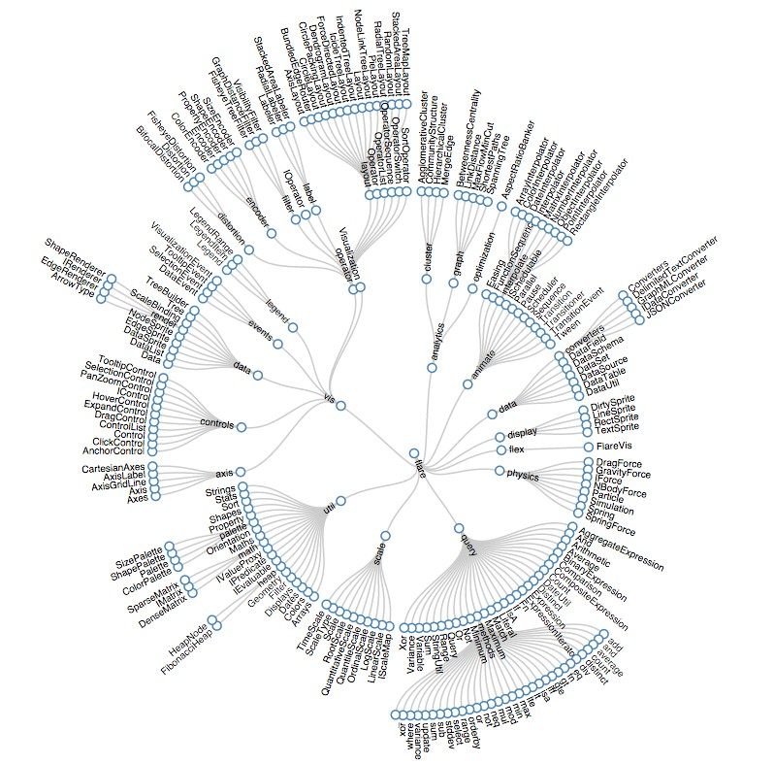
http://bl.ocks.org/mbostock/4063550

Slide 20
REINGOLD-TILFORD
repeatedly divide space for subtrees by leaf count
breadth of tree along one dimension
depth along the other dimension

Slide 21
REINGOLD-TILFORD
goal
make smarter use of space
maximize density and symmetry

Slide 22
REINGOLD-TILFORD
design concerns
clearly encode depth level
no edge crossings
isomorphic subtrees drawn identically
compact

Slide 23
REINGOLD-TILFORD
approach
bottom up recursive approach
for each parent make sure every subtree is drawn
pack subtrees as closely as possible
center parent over subtrees

Slide 24
LAYERED DIAGRAMS
recursive subdivision of space
structure encoded using:
layering
adjacency
alignment

Slide 25
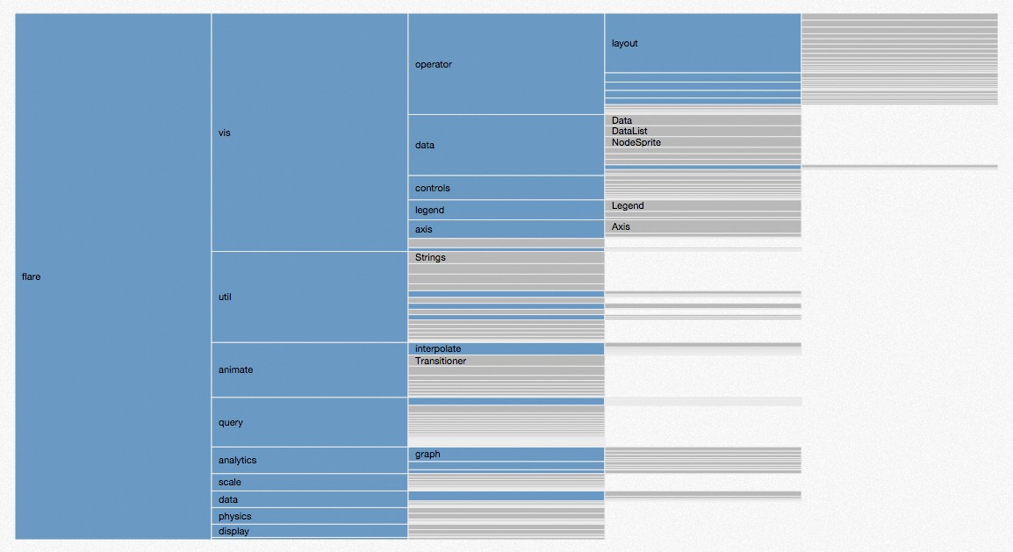
http://mbostock.github.io/d3/talk/20111018/partition.html

Slide 26
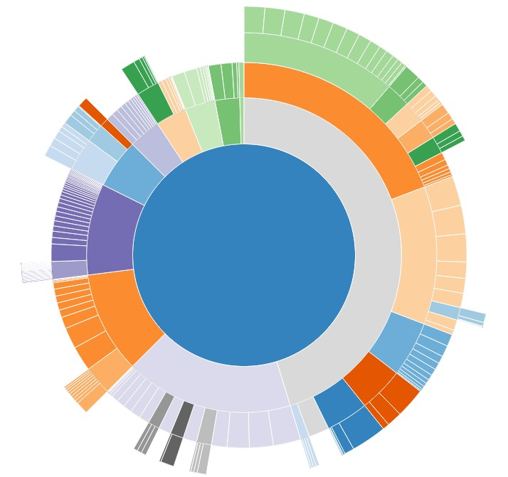
http://bl.ocks.org/mbostock/raw/4348373/

Slide 27
SCALE PROBLEM
tree breadth often grows exponentially—quickly run out of space!
solutions
scrolling or panning
filtering or zooming
hyperbolic layout

Slide 28
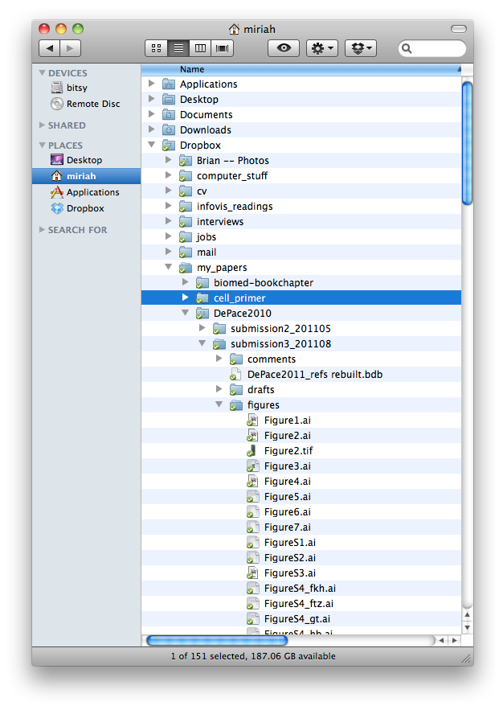
INDENTATION
indentation used to show parent/child relationships
breadth and depth contend for space
problem: often requires a great deal of scrolling

Slide 29







ENCLOSURE DIAGRAMS
encode structure using spatial enclosure
often referred to as treemaps
benefits
provides single view of entire tree
easier to spot small / large nodes
problems
difficult to accurately read depth
B
C
A
D
B
C
=
A
E
D
E

Slide 30

http://www.derlien.com/

Slide 31
TREEMAPS
recursively fill space based on a size metric for nodes
enclosure indicates hierarchy
additional measures can control aspect ratio of cells
most often use rectangles, but other shapes possible
square, circle, voronoi tessellation
A:10
C:3
B:7
D:3
E:1
F:3
G:1
H:2
C | G | H
 | E
 | F
B
D

Slide 32
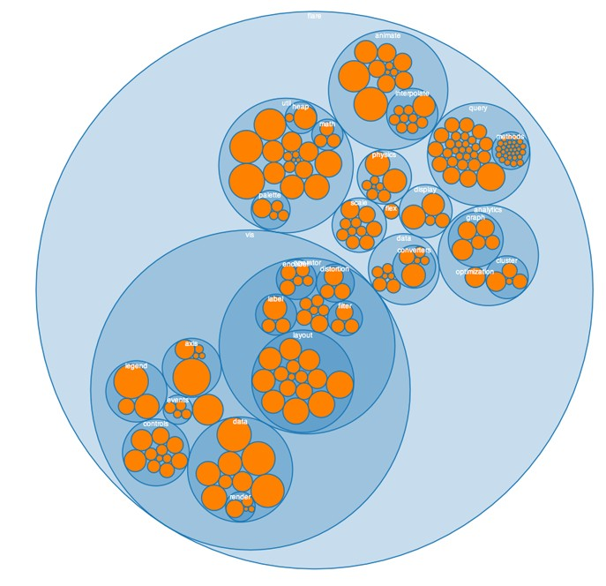
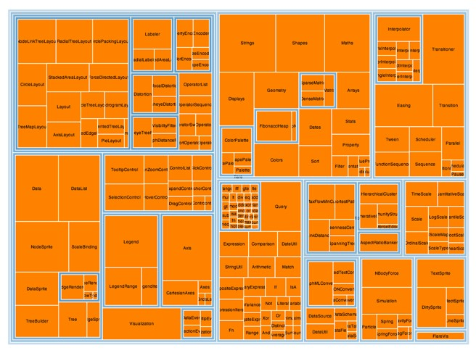
http://hci.stanford.edu/jheer/files/zoo/

Slide 33

https://www.nytimes.com/interactive/2017/02/27/us/politics/most-important-problem-gallup-polling-question.html?smid=pl-share

Slide 34
VISUALIZING GRAPHS

Slide 35
Graph Drawing Exercise
create an aesthetically pleasing node-link diagram representation
 | 1 | 2 | 3 | 4 | 5 | 6 | 7 | 8 | 9 | 10
1 | 0 | 0 | 1 | 0 | 0 | 1 | 1 | 0 | 0 | 0
2 | 0 | 0 | 1 | 0 | 0 | 1 | 0 | 1 | 1 | 0
3 | 1 | 1 | 0 | 0 | 0 | 0 | 0 | 0 | 0 | 1
4 | 0 | 0 | 0 | 0 | 1 | 0 | 1 | 0 | 1 | 0
5 | 0 | 0 | 0 | 1 | 0 | 0 | 0 | 1 | 0 | 0
6 | 1 | 1 | 0 | 0 | 0 | 0 | 0 | 0 | 1 | 1
7 | 1 | 0 | 0 | 1 | 0 | 0 | 0 | 1 | 0 | 0
8 | 0 | 1 | 0 | 0 | 1 | 0 | 1 | 0 | 0 | 0
9 | 0 | 1 | 0 | 1 | 0 | 1 | 0 | 0 | 0 | 0
10 | 0 | 0 | 1 | 0 | 0 | 1 | 0 | 0 | 0 | 0

Slide 36
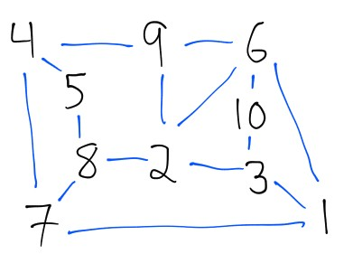
GRAPH DRAWING EXERCISE
create an aesthetically pleasing node-link diagram representation

Slide 37
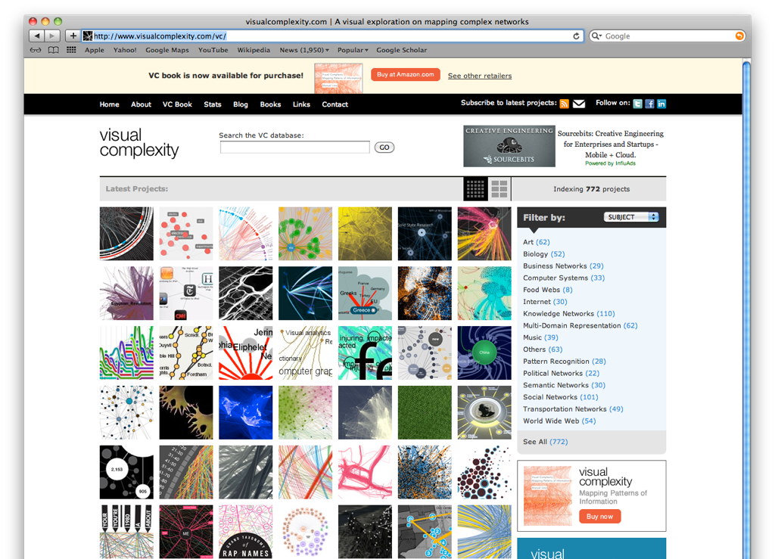
39

Slide 38
VISUALIZING GRAPHS
node link layouts
Reingold-Tilford (discussed previously)
Sugiyama (directed acyclic graphs)
Force directed
Attribute-based
adjacency matrices
aggregate views
Motif Glyphs
PivotGraph

Slide 39
SPATIAL LAYOUT
primary concern of graph drawing is the spatial layout of nodes and edges
often (but not always) the goal is to effectively depict the graph structure
connectivity, path-following
network distance
clustering
ordering (e.g., hierarchy level)

Slide 40
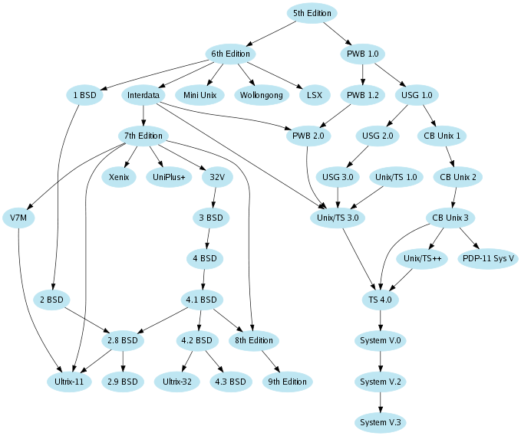
SUGIYAMA
great for graphs that have an intrinsic ordering
depth not strictly encoded
What is the depth of V7M?
UNIX ancestry

Slide 41
SUGIYAMA
+ nice, readable top down flow
+ relatively fast (depending on heuristic used for crossing minimization)
- not really suitable for graphs that don’t have an intrinsic top down structure
- hard to implement
use free graphviz lib: http://www.graphviz.org

Slide 42
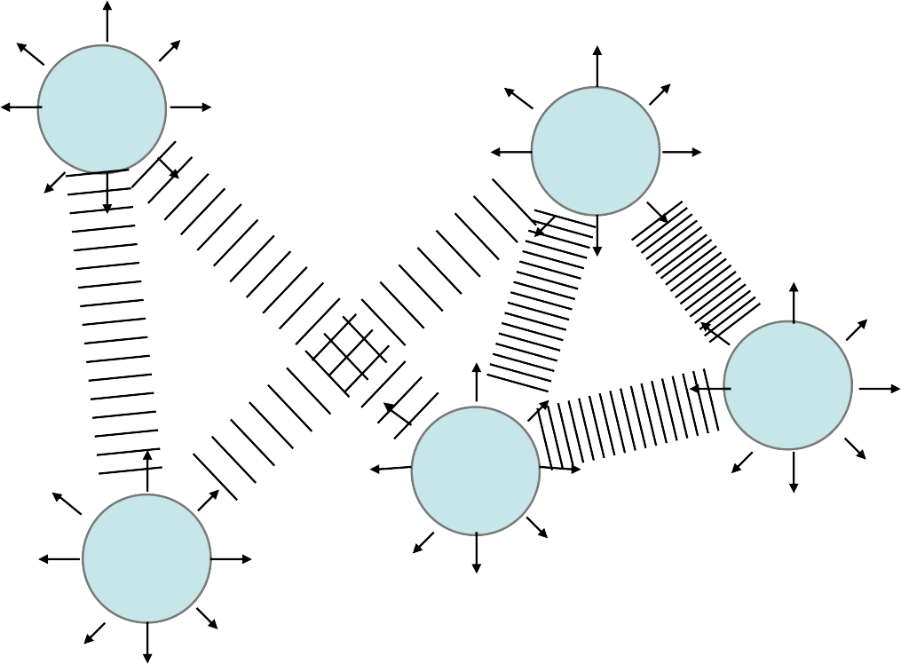
FORCE-DIRECTED
no intrinsic layering, now what?
physically-based model
edges = springs
nodes = repulsive particles

Slide 43
FORCE MODEL
many variations, but usually physical analogy of repulsion and attraction

Slide 44
FORCE MODEL: Repulsive Forces
f_{R}(d) = C_{R} * m₁ * m₂ / d²
C_{R} is a strength constant
m₁, m₂ are node masses
d is a distance between nodes

Slide 45
FORCE MODEL: Attractive Forces
f_{A}(d) = C_{A} * (d – L)
C_{A} is a strength constant
d is a distance between nodes
L is the rest length of the spring (i.e. Hooke’s Law)

Slide 46
FORCE MODEL
Every node feels repulsion to every other node
Only connected nodes feel attracted

Slide 47
FORCE MODEL
Repulsive force:
F_{R}(P) = Σ_{all neighbors(Q)} f_{R}(||Q-P||) * (Q-P)
Attractive force:
F_{A}(P) = Σ_{connected neighbors (Q)} f_{A}(||P-Q||) * (P-Q)

Slide 48
FORCE MODEL
Use force to update acceleration
Use acceleration to update velocity
Use velocity and acceleration to update position

Slide 49
ALGORITHM
start from random layout
(global) loop:
for every node pair compute repulsive force
for every edge compute attractive force
accumulate forces per node and update velocity
update each node position in direction of velocity
stop when layout is ‘good enough’

Slide 50
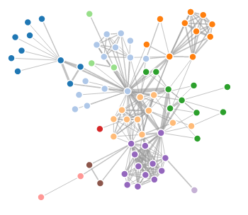
http://bl.ocks.org/mbostock/4062045

Slide 51
Thoughts?

Slide 52
FORCE DIRECTED
+ very flexible, aesthetic layouts on many types of graphs
+ can add custom forces
+ relatively easy to implement
http://bl.ocks.org/mbostock/4062045

Slide 53
FORCE DIRECTED
- repulsion loop is O(n²) per iteration
can speed up to O(n log n) using quadtree or k-d tree
- prone to local minima
can use simulated annealing
- doesn’t work well on highly connected (low diameter) graphs
http://bl.ocks.org/mbostock/4062045

Slide 54
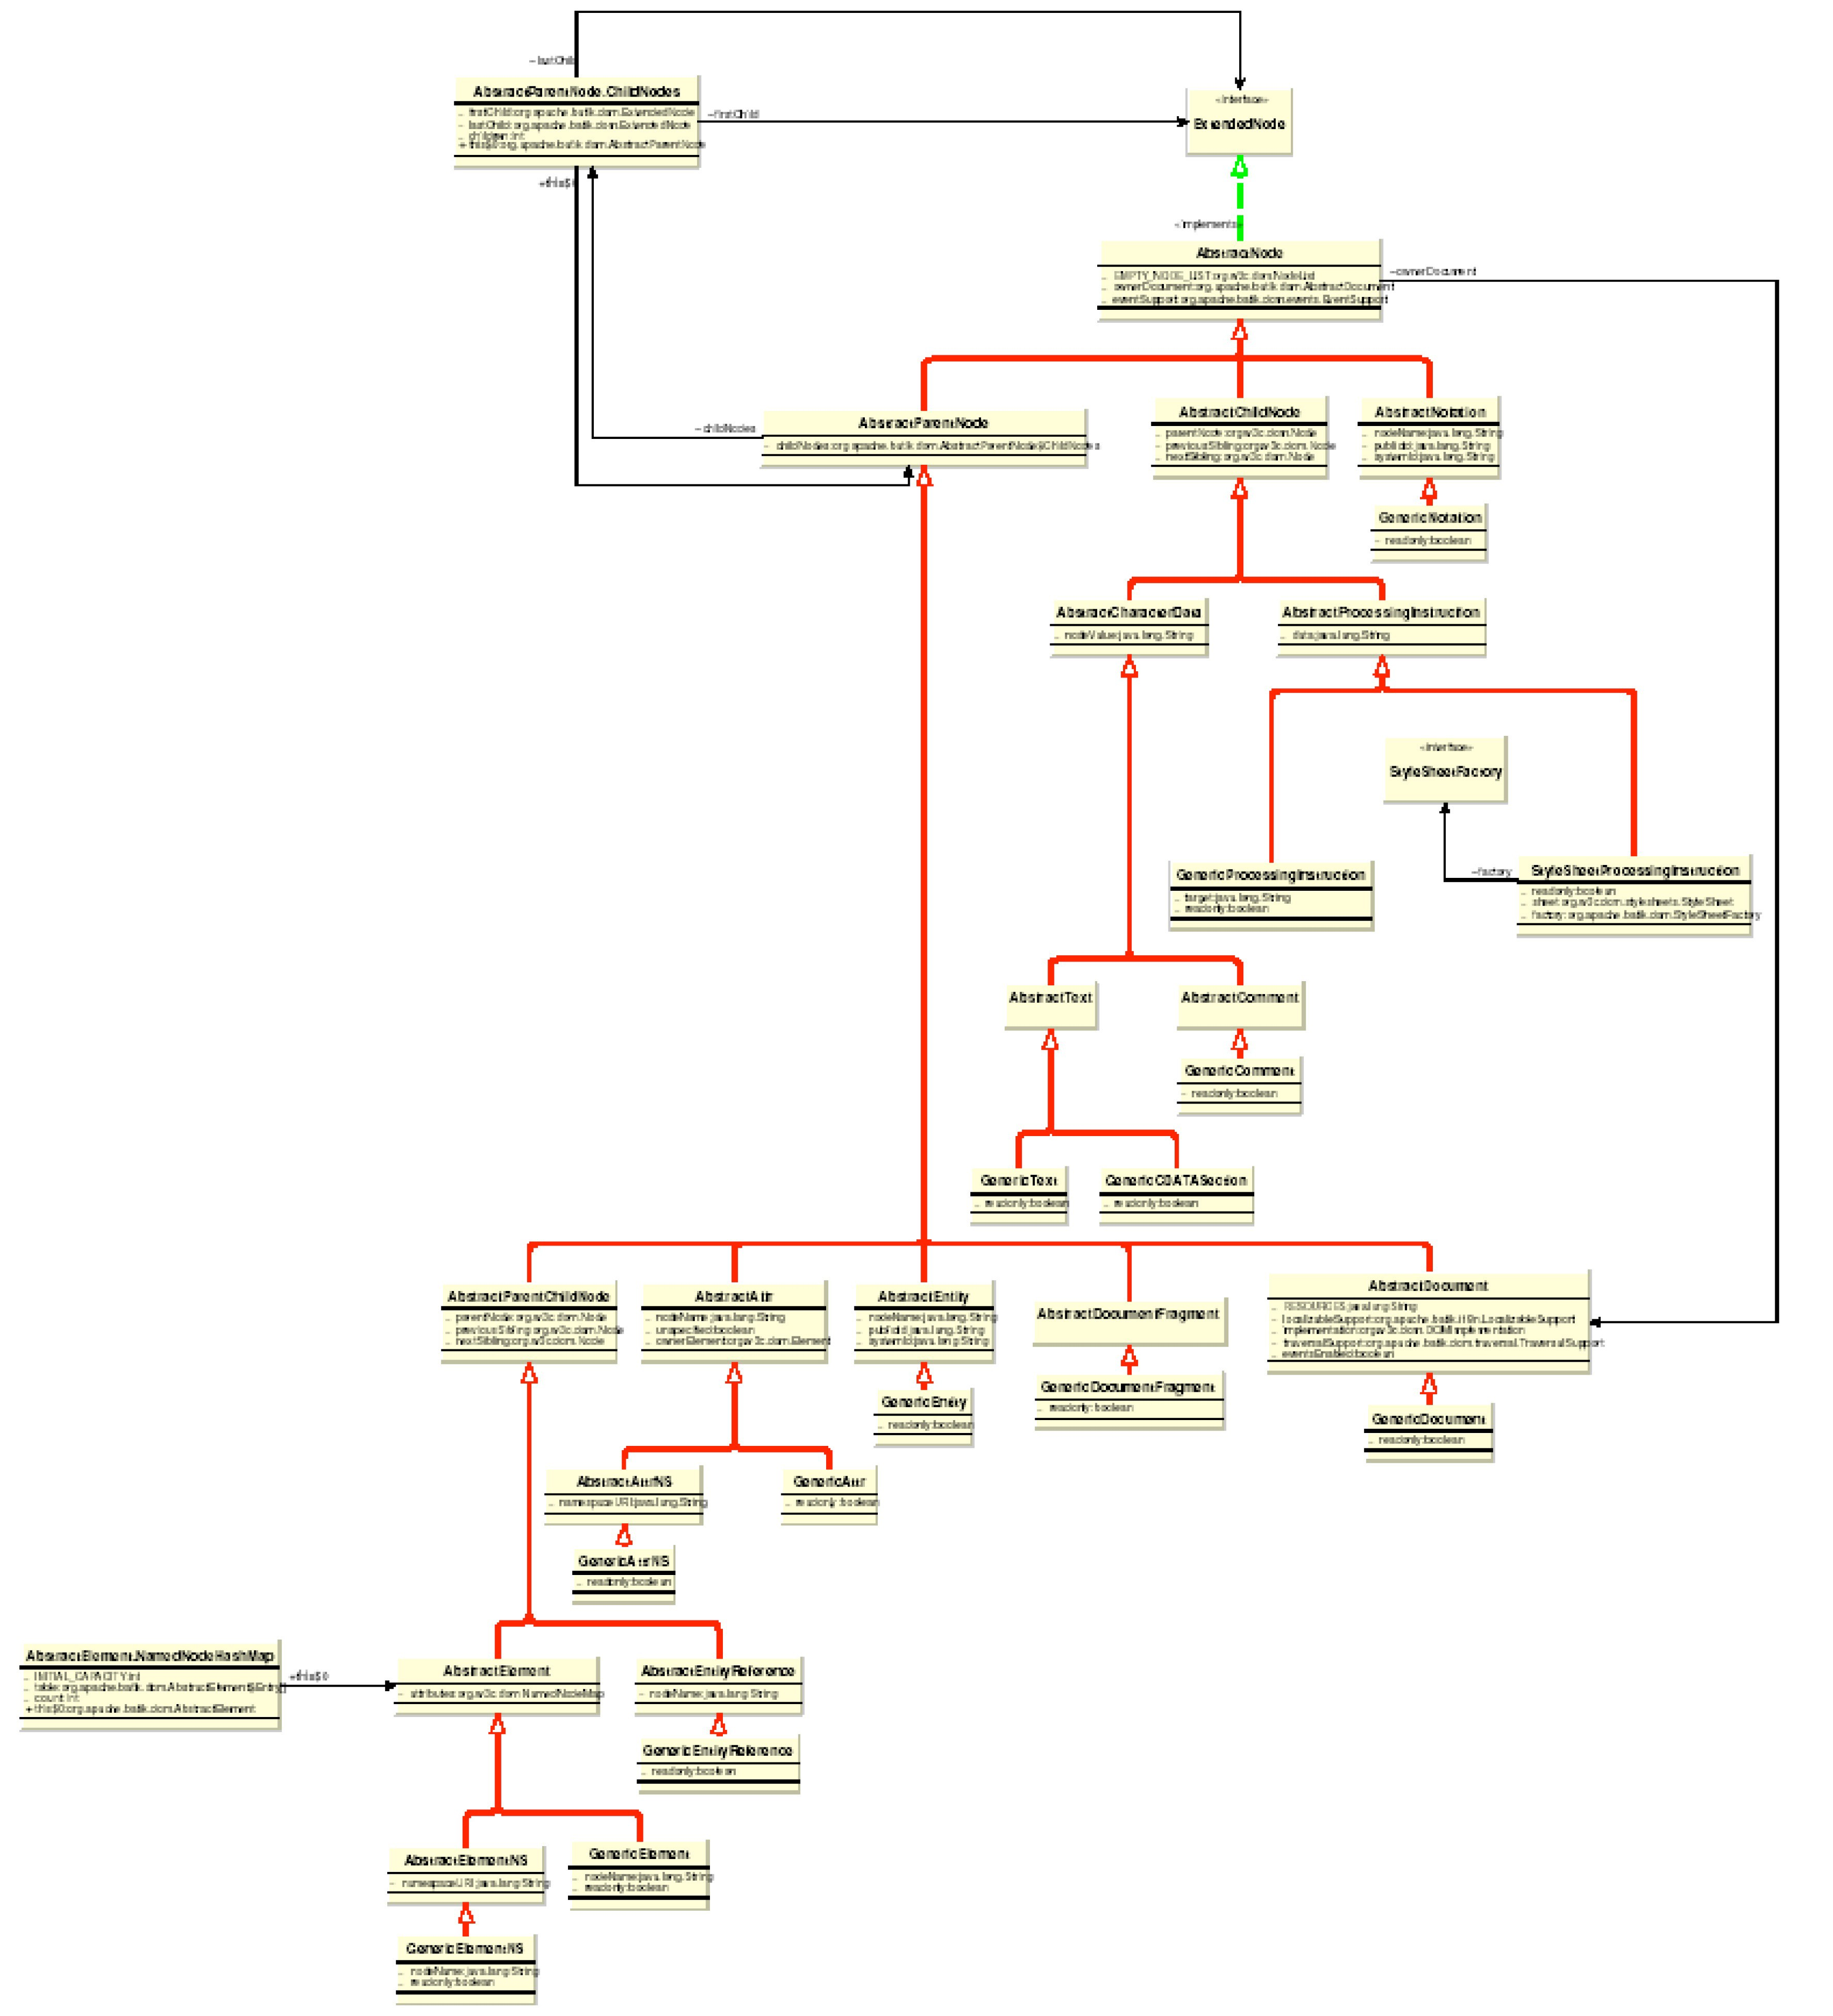
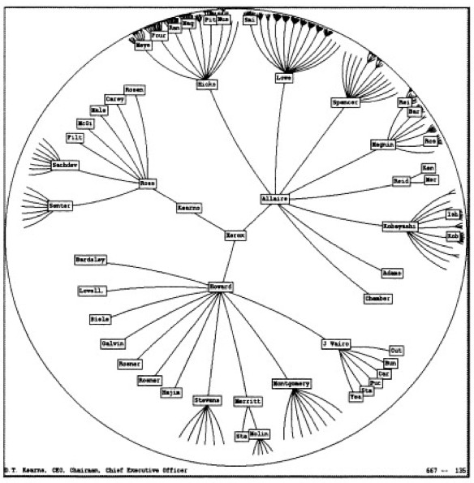
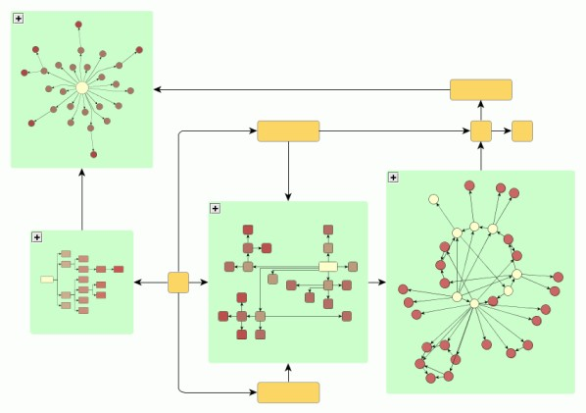
OTHER LAYOUTS
orthogonal
great for UML diagrams
algorithmically complex
circular layouts
emphasizes ring topologies
used in social network diagrams
nested layouts
recursively apply layout algorithms
great for graphs with hierarchical structure

Slide 55

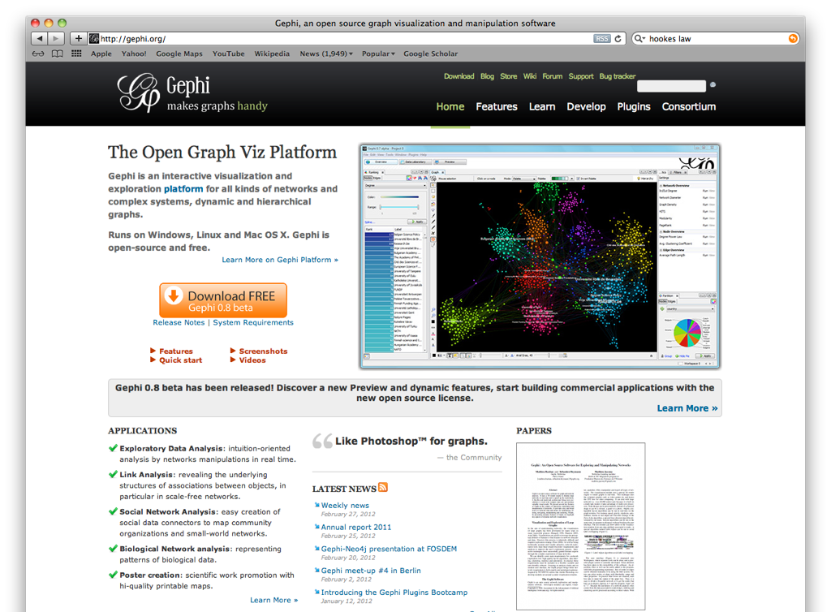
52

Slide 56
ATTRIBUTE-DRIVEN LAYOUT
large node-link diagrams get messy!
are there additional structures to exploit?
idea: use data attributes to perform layout
e.g., scatterplot based on node values
dynamic queries and/or brushing can be used to enhance perception of connectivity

Slide 57
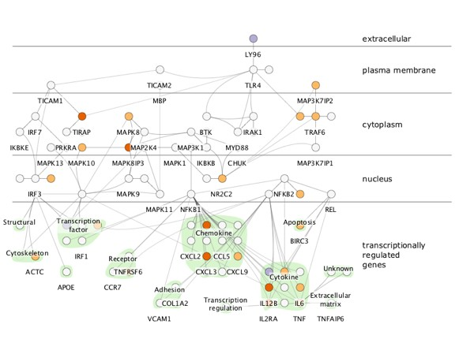
cerebral
Barsky 2008

Slide 58
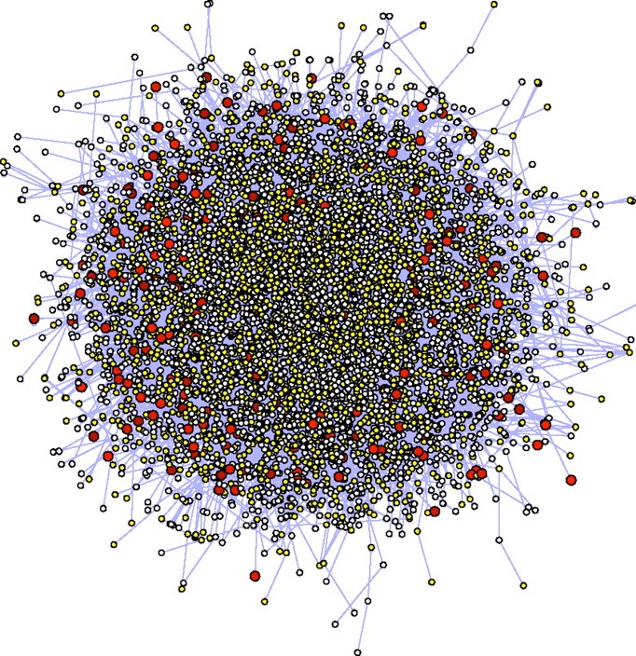
NODE LINK
+ understandable visual mapping
+ can show overall structure, clusters, paths
+ flexible, many variations
- all but the most trivial algorithms are > O(n²)
- not good for dense graphs
hairball problem!

Slide 59




A
ALTERNATIVE: ADJACENCY MATRIX
instead of node link diagram, use adjacency matrix representation
B
C
D
E
A
B
C
D
E
A
B
C
D
E

Slide 60
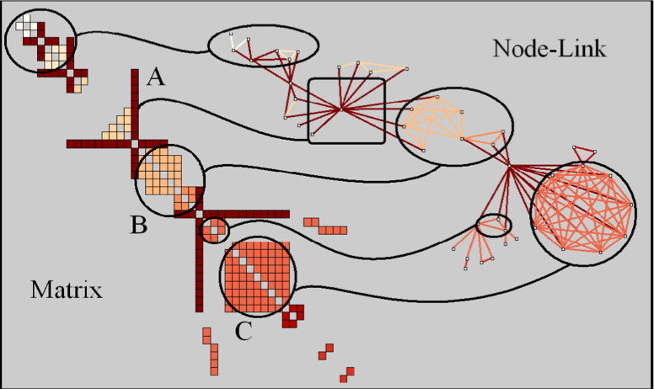
SPOTTING PATTERNS IN MATRICES
Henry 2006

Slide 61
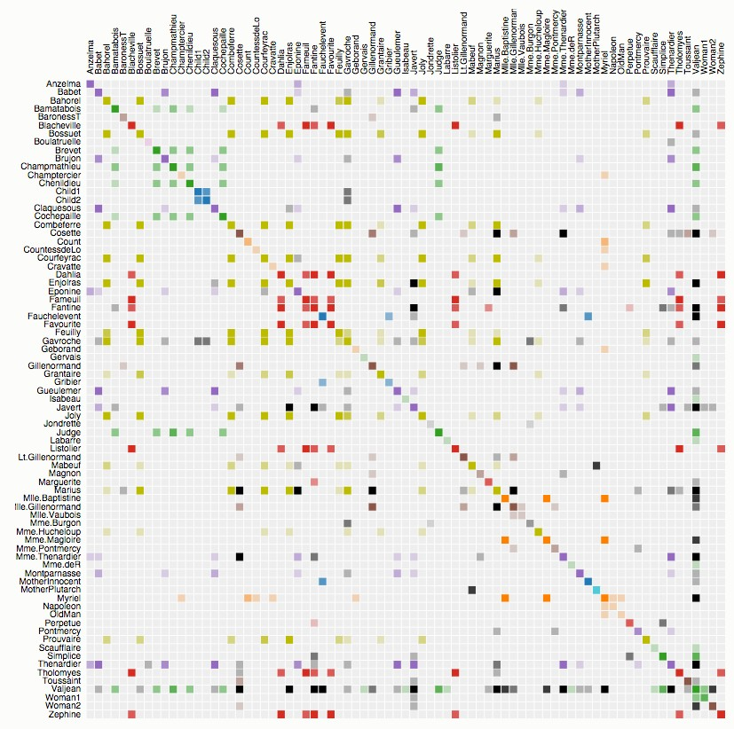
Les Misérables
character co-occurrence
http://bost.ocks.org/mike/miserables/

Slide 62
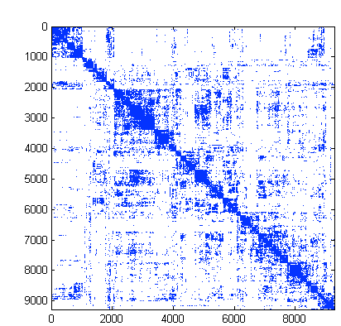
Adjacency Diagram
+ great for dense graphs
+ visually scalable
+ can spot clusters
- row order affects what you can see
- abstract visualization
- hard to follow paths

Slide 63
AGGREGATE VIEWS

Slide 64
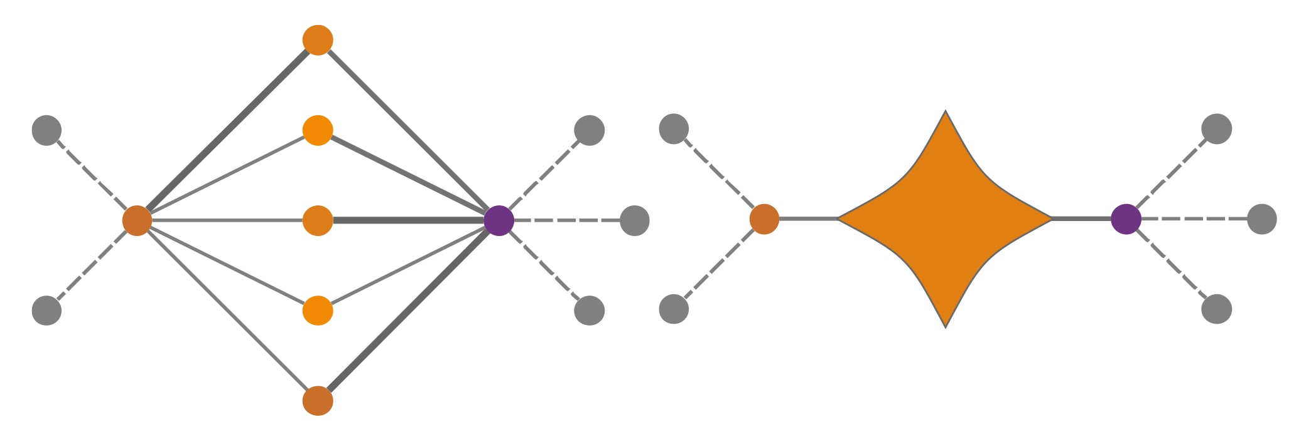
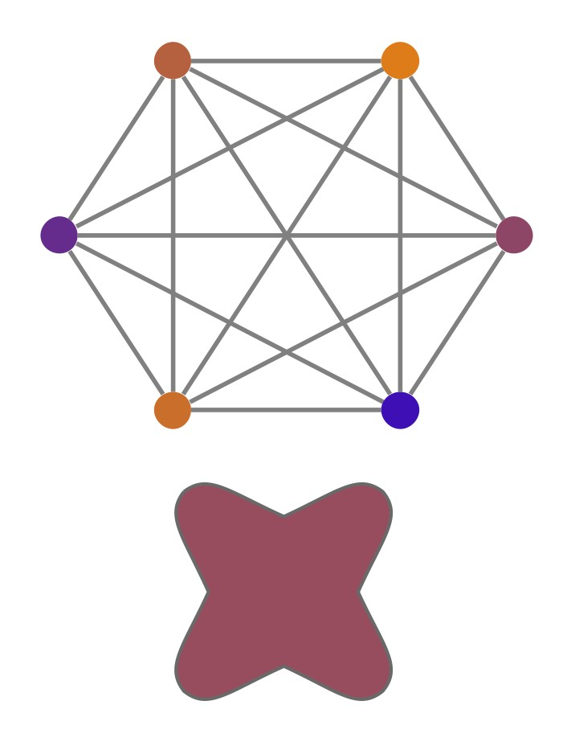
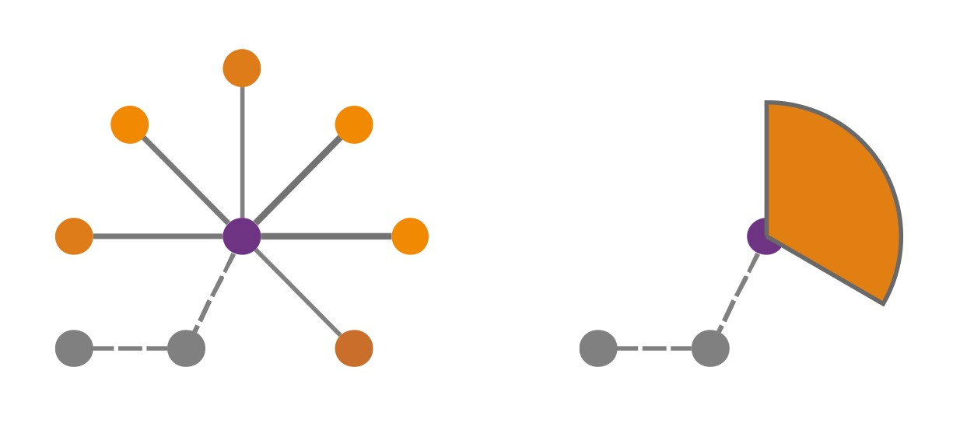
MOTIF GLYPHS
Connector
Clique
Fan
Dunne 2013

Slide 65
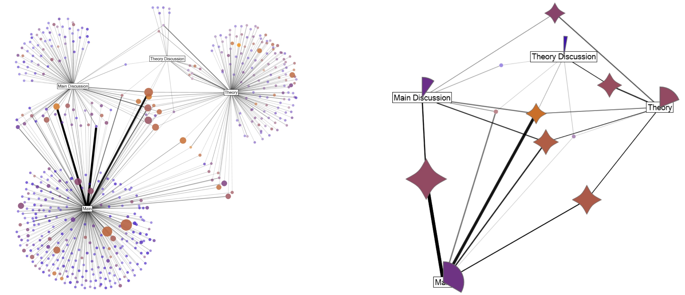
MOTIF GLYPHS
Dunne 2013

Slide 66
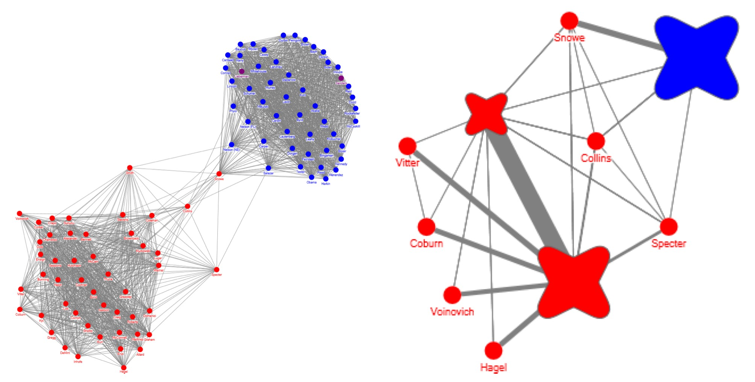
MOTIF GLYPHS
Dunne 2013

Slide 67
CRITIQUE
When can you use this technique?
When should you use this technique?

Slide 68
RECAP

Slide 69
TREES
indentation
simple, effective for small trees
node link and layered
looks good but needs exponential space
enclosure (treemaps)
great for size related tasks but suffer in structure related tasks

Slide 70
GRAPHS
node link
familiar, but problematic for large or dense graphs
adjacency matrices
abstract, hard to follow paths
aggregation can help
not always possible, not always appropriate
extracting structure can help
unclear how crosscutting it will be

Slide 71
TAKE HOME MESSAGE: no best solution

Slide 72
Recommended Reading
Visualization Analysis & Design: Chapter 9 (pp. 200-217)

